Slide 1

Presents
2-Day Workshop on
Front-End Development

Slide 2


Slide 3


Slide 4


Slide 5


Slide 6


Slide 7


Before & After of a Student after CollegeSaksham
The reason Colleges ask their students to take our program - to be Industry Ready

Slide 8


Slide 9


Slide 10
Let’s Get Started!
2-Day Workshop on
Front-End Development

Slide 11
Workshop Plan Link:
Click Here
2-Day Plan

Slide 12
Introduction to Full Stack Development

Slide 13
Full Stack Development
How Internet Works
URL & Domain Name
Web Server HTTP Request
Client & Server
Overview

Slide 14
What is Full Stack Development?
Refers to both Front-End and Backend Development
Ability to design complete Web Applications
Part I – Front End Development
Part II – Back End Development
Database to manage Different data manipulations
Debugging

Slide 15
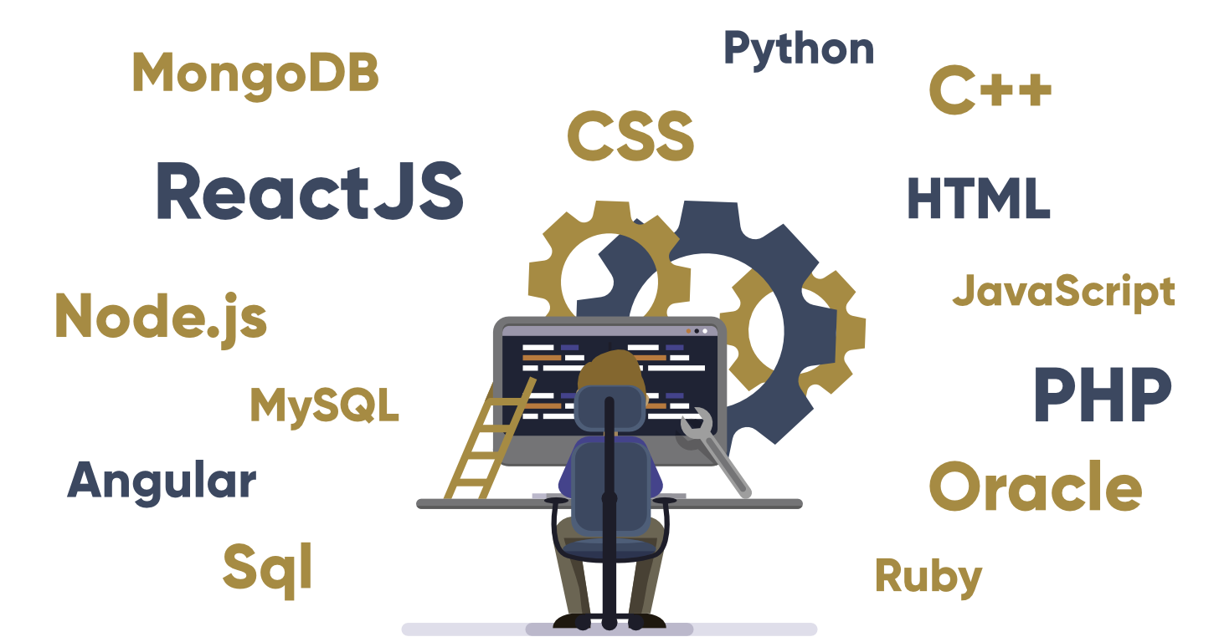

Slide 16
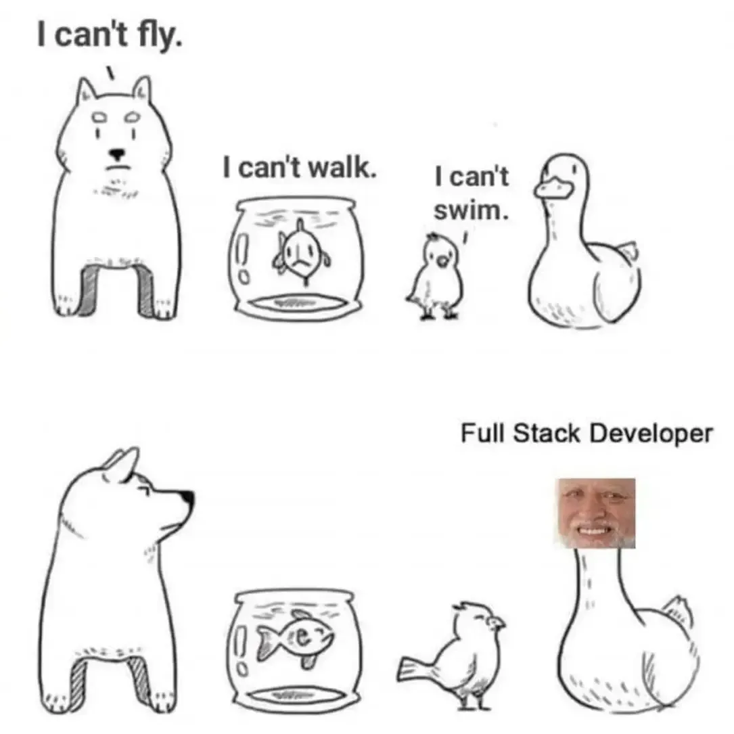

Slide 17
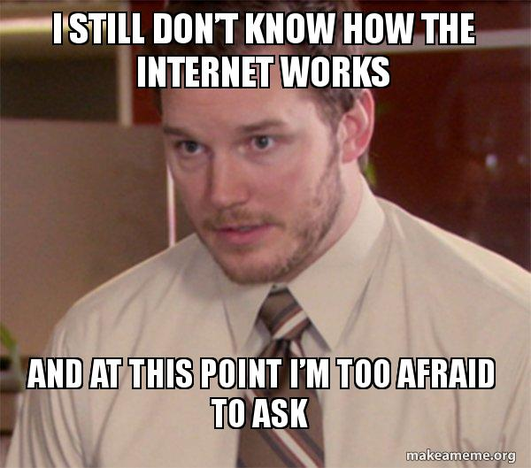
How Does the Internet Work?
What is Internet?
Main Components – Packets & Protocols
Basic Infrastructure of Internet
Working of Internet
Different Modes of Connecting to Internet
Internet Connection Protocols and main Pillars of the Internet.

Slide 18
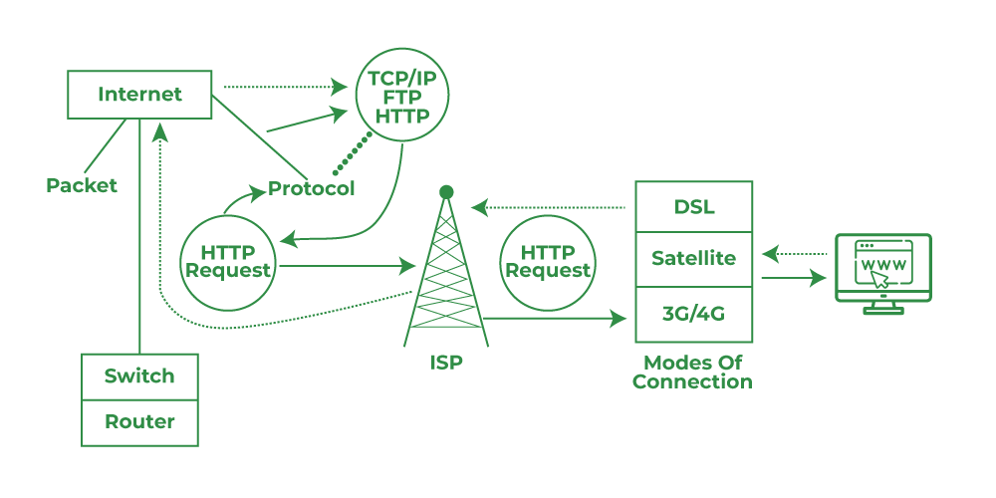


Slide 19
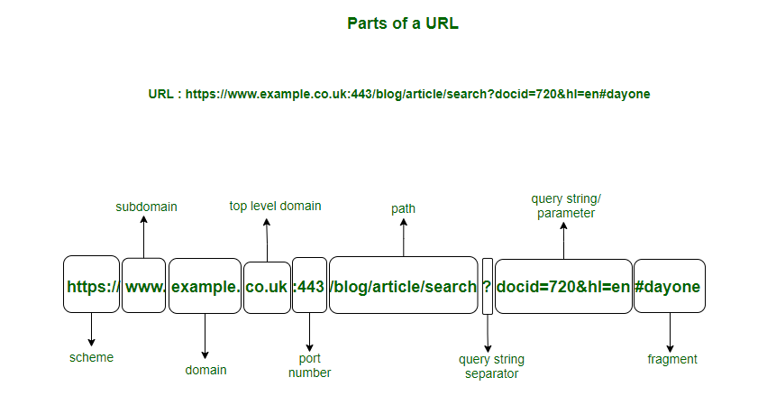
URL & Its Components

Slide 20
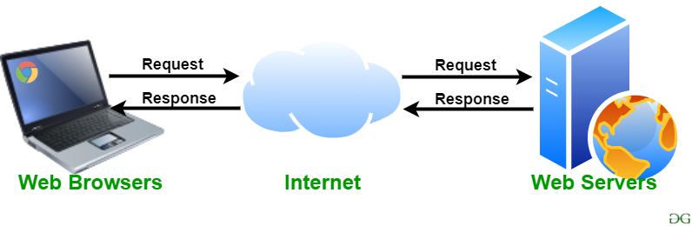
Web Server & Its Working
It is a computer where the web content is stored and used to host web sites etc.
Some Web Servers used in the market like Apache, IIS, Sun Java etc.
Working of Web server

Slide 21


Slide 22
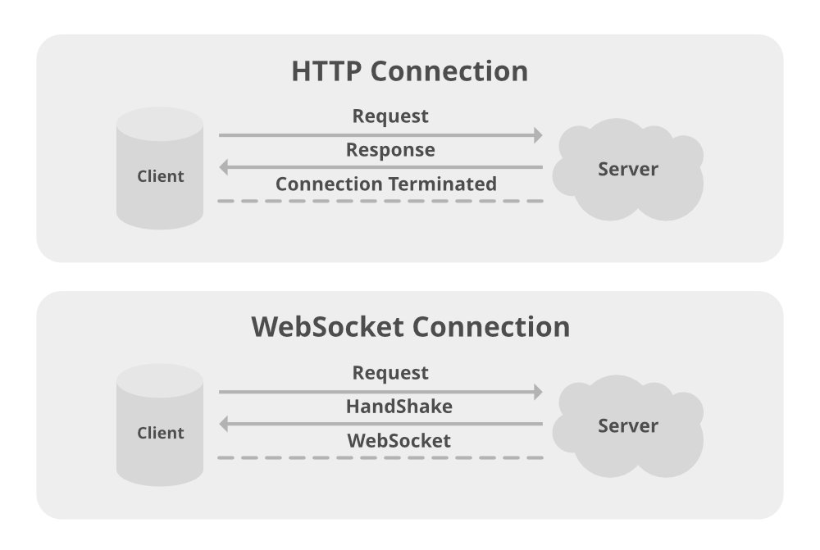
HTTP Request & Response
Hyper Text Transfer Protocol
HTTP Request Methods – GET/POST/PUT/PATCH/DELETE
Working of HTTP and common information present in HTTP request.
HTTP Headers
HTTP Response

Slide 23
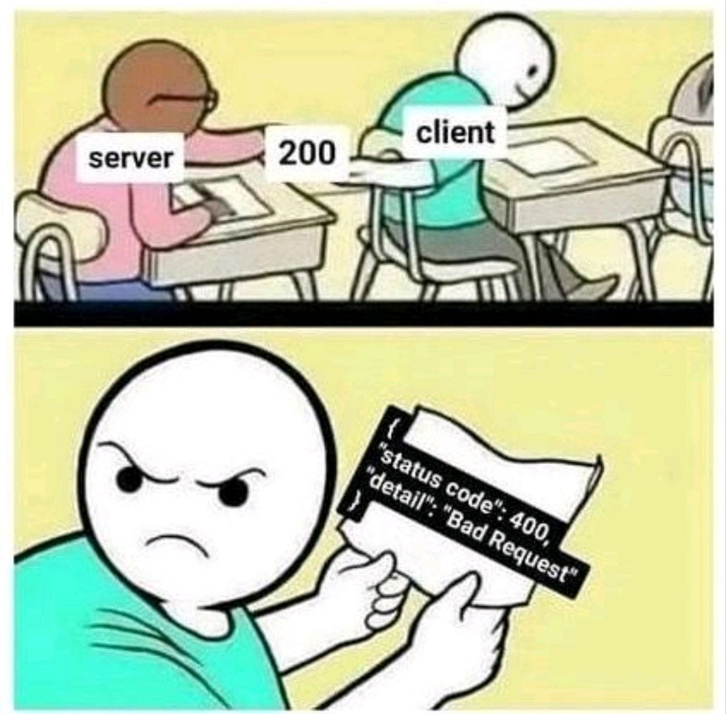

Slide 24

Also you need users to make a server to work!

Slide 25

How Client Server Model Works?
Client – It is a computer i.e., capable of receiving information from the service providers like Servers.
Server – It is remote computer which provides information to particular service.
Browser Interacts with Server.
Advantages of Client Server Model
Disadvantages

Slide 26
Full Stack Development How Internet Works URL & Domain Name Web Server HTTP Request Client & Server
Review

Slide 27
Quiz Time

Slide 28
DIY
Keep Learning, Keep Exploring

Slide 29
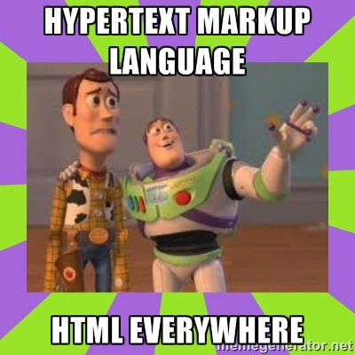
HTML Elements

Slide 30
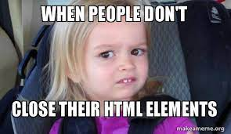
Container Tags
Nested Elements
Empty Tags
DOM Tree
DIV tags
HTML Nodes
Overview

Slide 31
Container Tags
Division Tag - <div>
Text Formatters - <p>, <b>, <i>
Hyperlinks -<a>
Lists Tag - <ul> <ol>
Script Tag - <script>
Headings Tag - <h1> -- <h6>

Slide 32
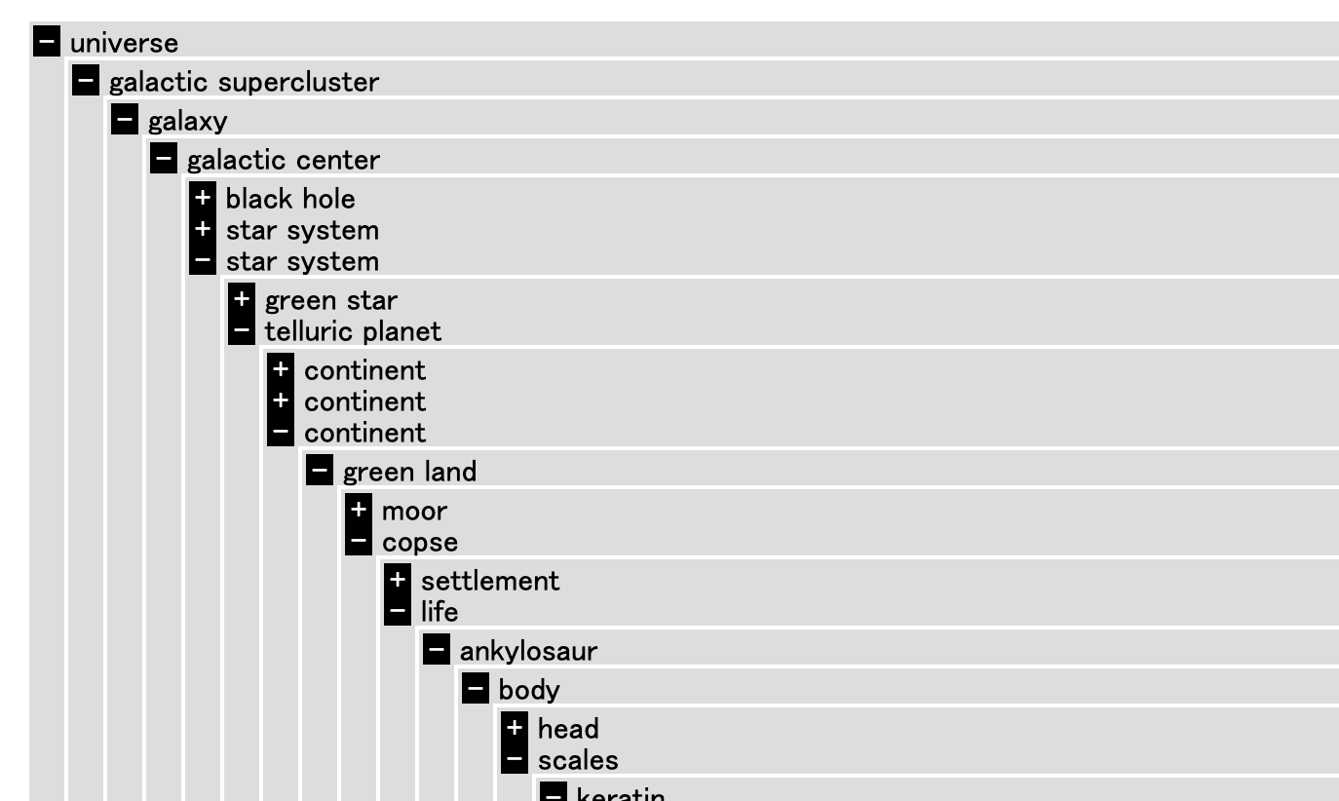
Nested Elements
HTML elements can be nested
All Docs contains Nested elements
Example
Never Skip end Tag

Slide 33
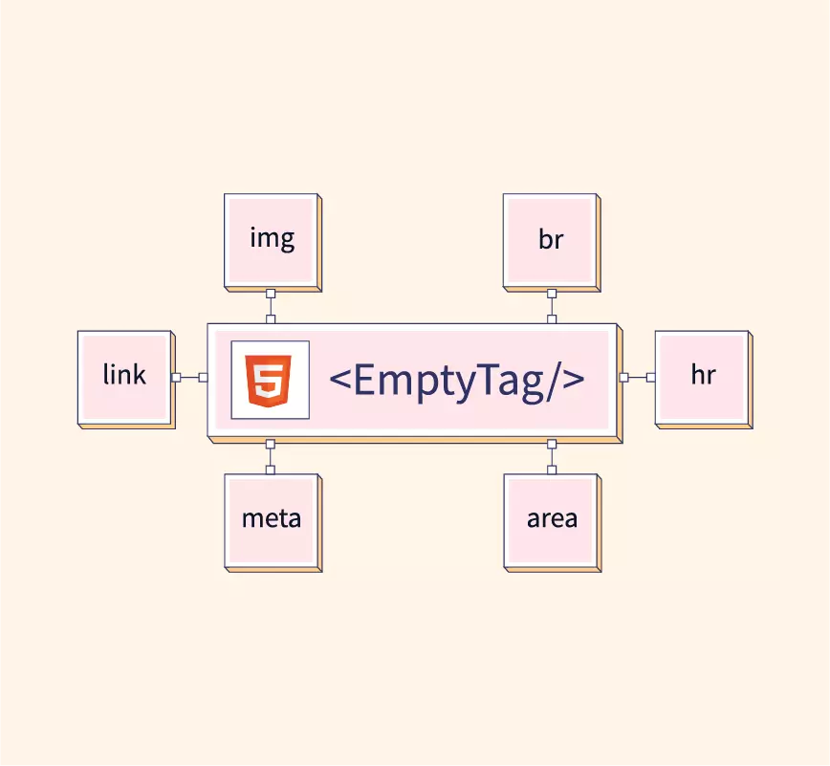
Empty Tags
<br>
<hr>
<img>
<input>
<meta>
<link>
<source>

Slide 34

HTML DOM
HTML DOM Document Object Model
Why DOM is Required
Finding HTML elements
Why called an Object Model?
Properties of DOM
Methods of DOM

Slide 35
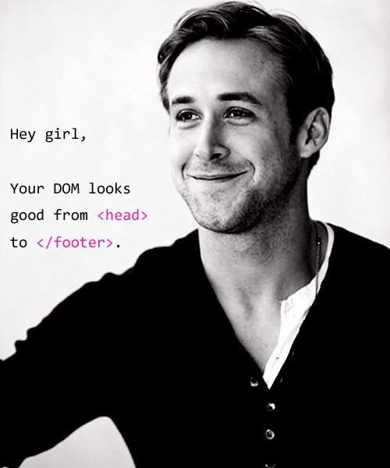
HTML Nodes
DOM is collection of Nodes with Child nodes
Nodes are element nodes, text nodes and comment nodes
Whitespace between elements are also text nodes
Child Nodes vs Children
Siblings' vs Elements siblings
HTML Nodes
Hey Girl/Boy,

Slide 36
Container Tags Nested Elements Empty Tags DOM Tree DIV tags HTML Nodes
Review

Slide 37
Quiz Time
https://bit.ly/mbufrm2

Slide 38
DIY
Keep Learning, Keep Exploring

Slide 39
HTML Attributes

Slide 40
What is HTML Attribute? Syntax
Supported Attributes Usage
Examples
Overview

Slide 41
HTML Attribute
Provide additional information about HTML elements
All HTML elements can have attributes
Attributes should always be applied with start tag.
Usually come in name/value pair.
Name and Values are case sensitive as recommended by W3C
Can add Multiple attributes in one HTML element by providing space between attributes.

Slide 42
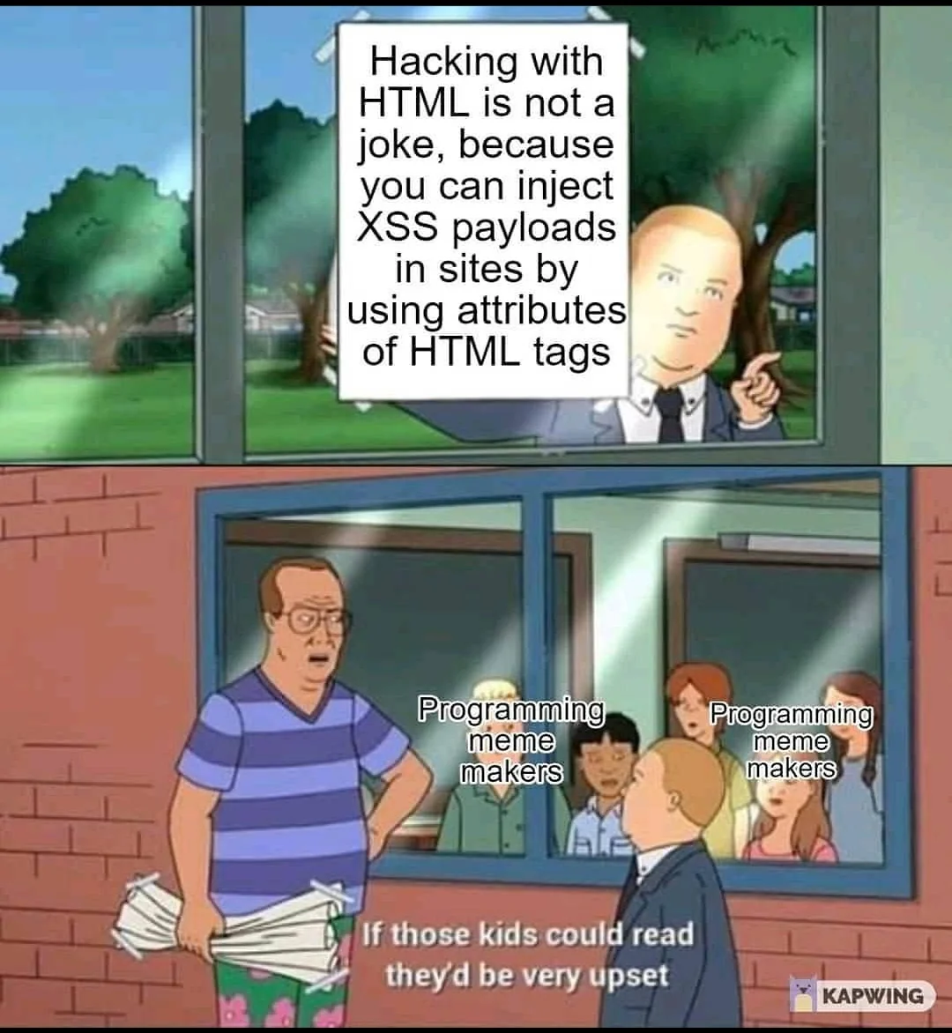
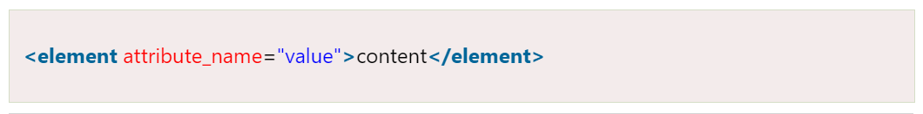
Syntax

Slide 43
Supported Attributes
lang
style
title
href
src
width
height
alt

Slide 44
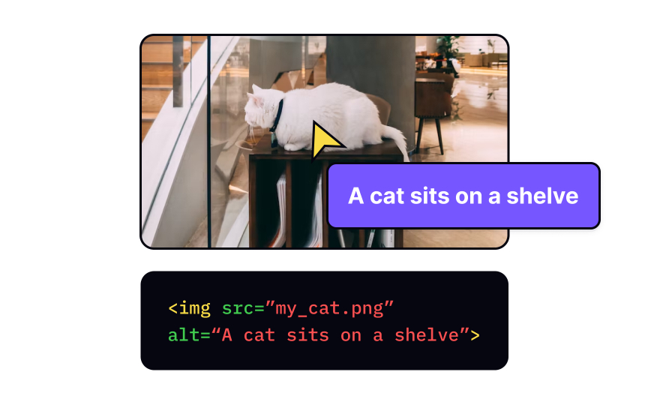
Usage of Attributes
Always Use Lowercase Attributes
Always Quote Attribute Values
Use of Single Quotes
Use of Double Quotes

Slide 45
Types of Attributes and their usage
lang: used inside <html>
title: define extra information about element
style: add styling to elements
href: used inside <a> define the hyperlink
src: used for <img> to specify the path to the image
width/height: used in <img> to specify height and width of image
alt : to define the alternate text to <img>

Slide 46
What is HTML Attribute? Syntax Supported Attributes Usage Examples
Review

Slide 47
Quiz Time
https://bit.ly/mbufrm3

Slide 48
DIY
Keep Learning, Keep Exploring

Slide 49
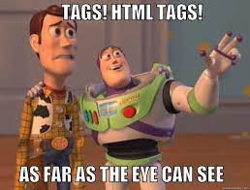
HTML Tags - I

Slide 50
Heading Tags
Paragraph Tag Line Break and Horizontal Rule
Anchor Tag Lists
Image & Video Tag
Overview

Slide 51
HTML Headings
HTML Headings are titles or subtitles.
They are defined with <h1> to <h6> tags.
<h1> defines the most important heading
<h6> defines the least important heading
Importance of Headings – Search Engine use the headings to index the content of the web page. Its important to use headings to show the document structure.

Slide 52
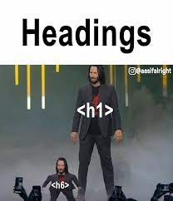

Slide 53
Paragraph Tag
It always starts on a new line, usually a block of text
HTML <p> element defines a paragraph.
Browser automatically adds some margin before and after para.
HTML <pre> element which preserves both spaces and line breaks.
Example for <p> and <pre>

Slide 54
Margin Tags
Horizontal Rule
<hr> defines the break in HTML page represented by Horizontal rule
<hr> separates content in the HTML Page
<hr> tag is empty tag which means it has no end tag.
Line Break
HTML <br> defines a line break
Use <br> if you want a line break without starting a new paragraph.
<br> tag is empty tag which means it has no end tag.

Slide 55
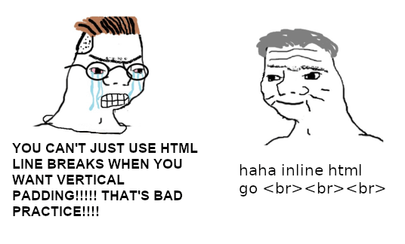
Css guy
Me who only knows html

Slide 56
Anchor
HTML <a> tag
<a> tag defines a hyperlink, used to link from one page to another
Most important attribute of <a> is href determines link destination
An unvisited link is underlined and blue
A visited link is underlined and purple
An active link is underlined and red Attributes and Examples for <a> tag

Slide 57
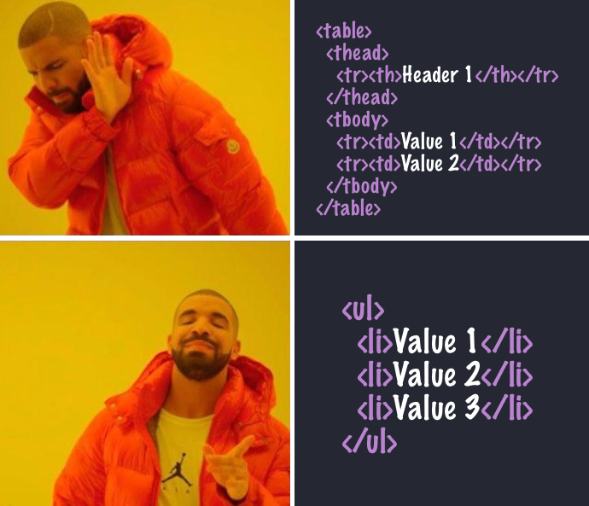
HTML Lists
It allows developers to group a set of related items in lists.
Unordered List - <ul> tag.
Ordered List - <ol> tag
HTML Description Lists - <dl> and <dt> with <dd>
Each List Item starts with <li> tag

Slide 58
Images and Videos
<img> tag is used to embed an image in HTML page. It creates a holding space for the referenced image.
Required Attributes in <img> tag is src, alt, width and height.
<video> tag is used to embed video content in HTML page.
It contains one or more <source> tags with different video sources
Supported Video formats – mp4, webm, ogg. Optional Attributes in <img> and <video> tags

Slide 59
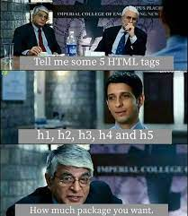
Heading Tags Paragraph Tag Line Break and Horizontal Rule Anchor Tag Lists Image & Video Tag
Review

Slide 60
Quiz Time
https://bit.ly/mbufrm4

Slide 61
DIY
Keep Learning, Keep Exploring

Slide 62
HTML Tags - II

Slide 63
Developer Tools in Chrome
HTML5 Semantic Tags
Types of Semantic Tags Visualization and Examples
Why Semantic Elements?
Overview

Slide 64

Developer Tools
Developer Tools often called dev tools, allow to inspect, test and debug the code.
It can be accessed on chrome using the right click and inspect.
Different Tabs in Dev Tools
Usage of Each Tab and Understand the importance.

Slide 65
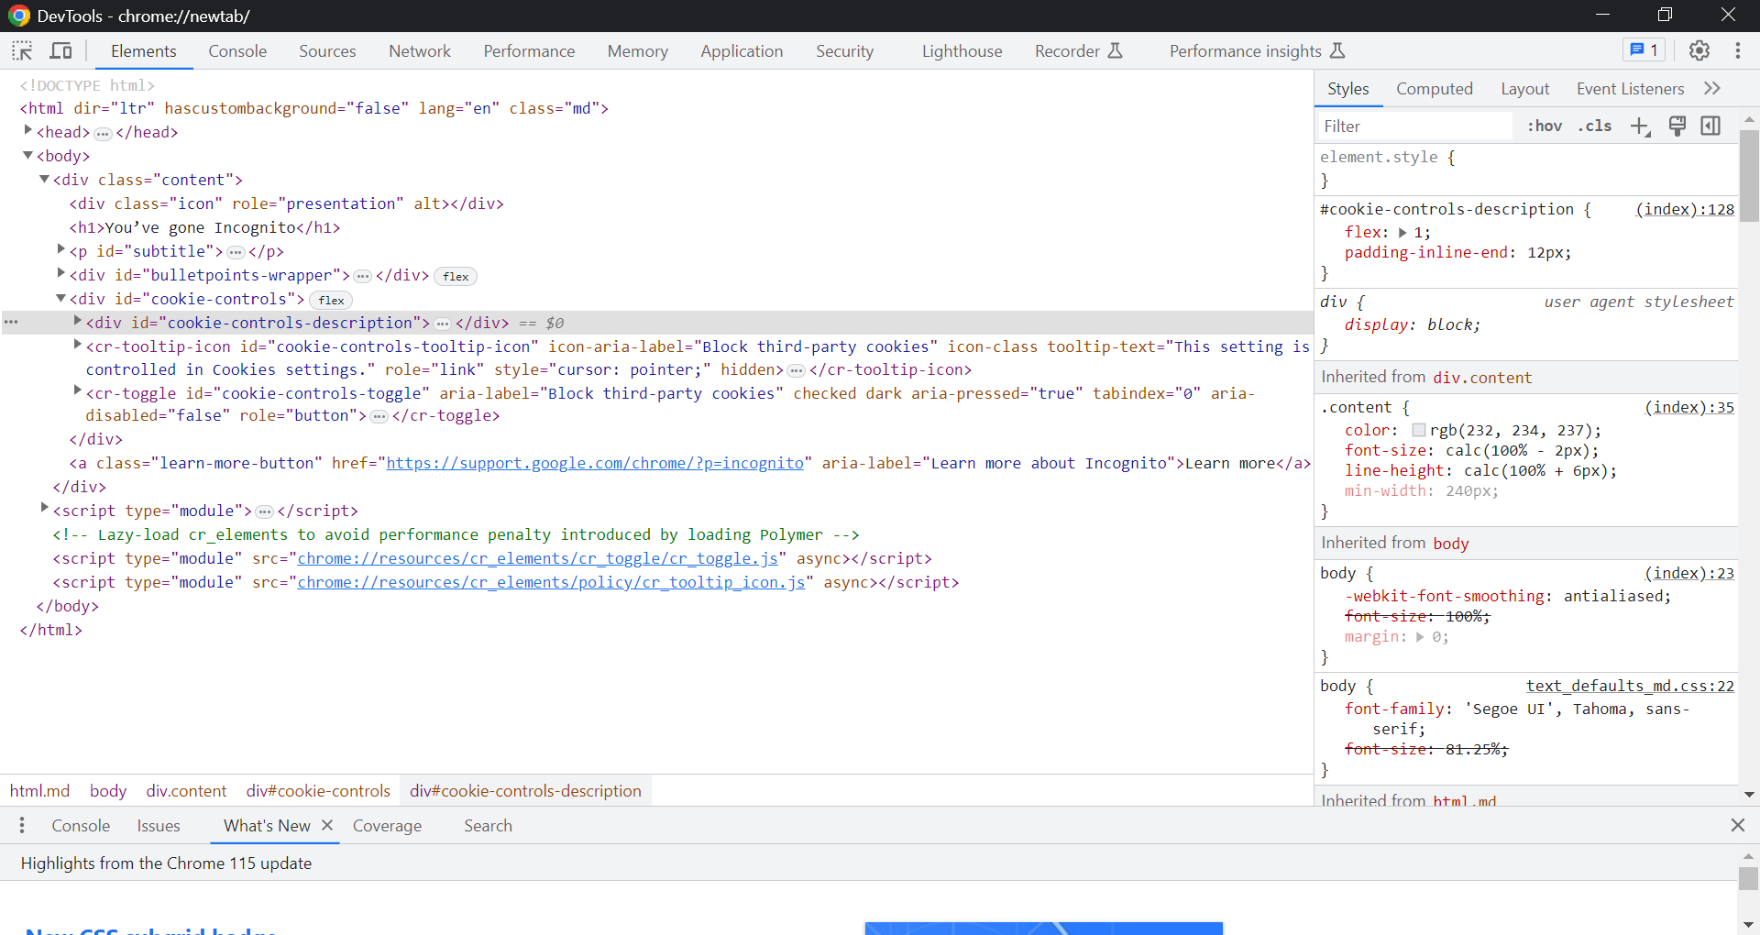

Visual Representation of Developer Tools

Slide 66
Semantic Elements in HTML5
Semantic Elements == Elements with a meaning
It describes the meaning to both browser and the developer
They are used to define the different parts of the web page.
Examples of non-semantic - <div> and <span> which tells nothing about its content. Semantic Tags - <form>, <article> - define its content and meaning

Slide 67
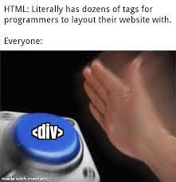
Most used tag is “div”

Slide 68
Semantic Elements
<article>
<aside>
<section>
<header>
<nav>
<footer>
<summary>
<main>
<figure>

Slide 69
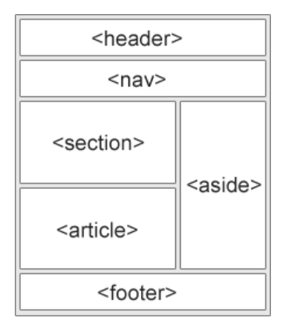
HTML5
Web Page Representation of Semantic Elements with examples

Slide 70
Usage of Semantic Elements
A Semantic Web Allows data to be shared and reused across applications, enterprises and communities.
They provide the meaning of the content visible in the document and browser itself.
Many websites contain HTML code like <div id=“nav”> , <div id=“header”> to indicate navigation and header, which can be easily achieved using Semantics.

Slide 71
Developer Tools in Chrome HTML5 Semantic Tags Types of Semantic Tags Visualization and Examples Why Semantic Elements?
Review

Slide 72
Quiz Time
https://bit.ly/mbufrm5

Slide 73
DIY
Keep Learning, Keep Exploring

Slide 74
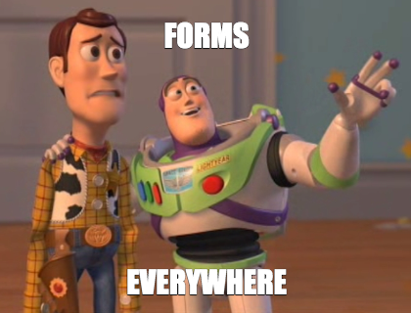
HTML Forms

Slide 75

What are HTML forms?
Different Attributes Different Form Elements
Input Types
Input Attributes
Demonstration of Forms
Overview

Slide 76
What are HTML Forms?
HTML Form is used to collect user Input.
This user input is most often sent to server for processing
<form> element is used to create HTML form for user input
It acts as container for different types of input elements such as text fields, radio buttons, submit buttons etc.

Slide 77
HTML Form Attributes
The action Attribute – action to be performed on form submission
The target Attribute – specifies where to display the response
The method Attribute – HTTP method to used when submitting form
The autocomplete and novalidate Attributes – when autocomplete on, browser complete values based on user input, when novalidate on, form data should not be validated when submit.

Slide 78
Form Elements
<input>
<label>
<select>
<textarea>
<button>
<fieldset>
<legend>
<option>
<datalist>

Slide 79
HTML Input Types
<input type=“button”>
<input type=“checkbox”>
<input type=“radio”>
<input type=“date”>
<input type=“password”>
<input type=“text”>
<input type=“submit”>
<input type=“range”>
<input type=“number”>
<input type=“color”>
<input type=“reset”>
<input type=“search”>

Slide 80
HTML Input Attributes
value
readonly
disabled
size
maxlength
min & max
pattern
placeholder
required
autofocus & autocomplete
height & width

Slide 81
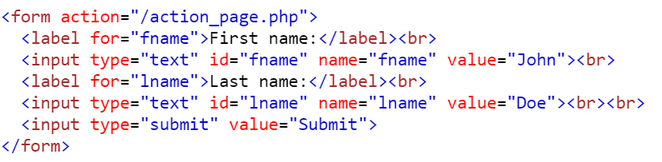
Example to Demonstrate Forms and Different elements

Slide 82
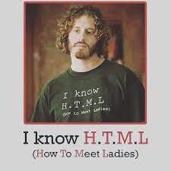
What are HTML forms? Different Attributes Different Form Elements Input Types Input Attributes Demonstration of Forms
Review

Slide 83
Quiz Time
https://forms.gle/jb5YYux8txa5gHR88

Slide 84
DIY
Keep Learning, Keep Exploring

Slide 85
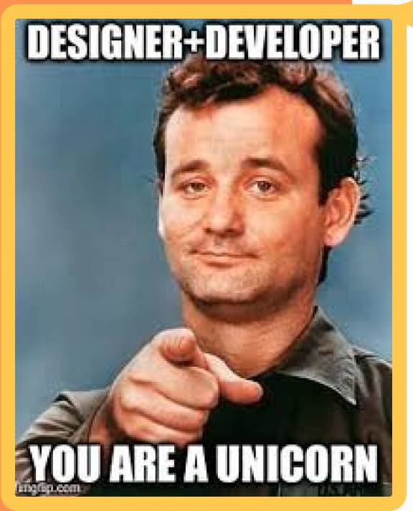
Introduction to CSS

Slide 86
What is CSS?
Why use CSS? CSS Syntax
How to Add CSS
Cascading Order
Demonstration of CSS
Overview

Slide 87
What is CSS?
CSS is language we use to style a web page.
CSS Stands for Cascading Style Sheets
It describes how HTML elements are to be displayed on the screen
It saves a lot of work. It can control the layout of multiple web pages all at once.

Slide 88
Why Use CSS?
CSS is used to define styles for your web pages.
It helps to provide design, layout and variations in display in different devices and screen size.
CSS removed the styling formatting from HTML page.
The style definitions are mostly saved in external .css files. With an external stylesheet file, you can change the look of an entire website by changing just one file.

Slide 89
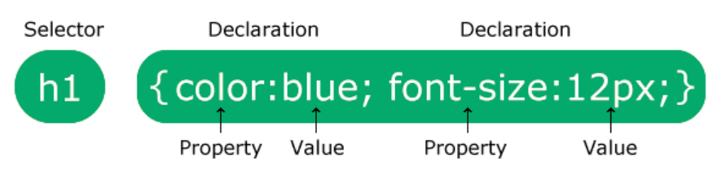
CSS Syntax
A CSS rule consists of selector and a declaration block.
Selector -> Points to HTML element you want to style
Declaration -> Block contains multiple declarations separated
Each declaration includes CSS property name and a value, separated by colon.

Slide 90
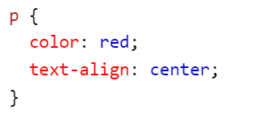
CSS Syntax
p is a selector in CSS (points to HTML element)
color is the property and red is the property value.
text-align is the property and center is the property value.

Slide 91
How to Add CSS
There are 3 ways of inserting a style sheet:
External CSS
Internal CSS
Inline CSS

Slide 92
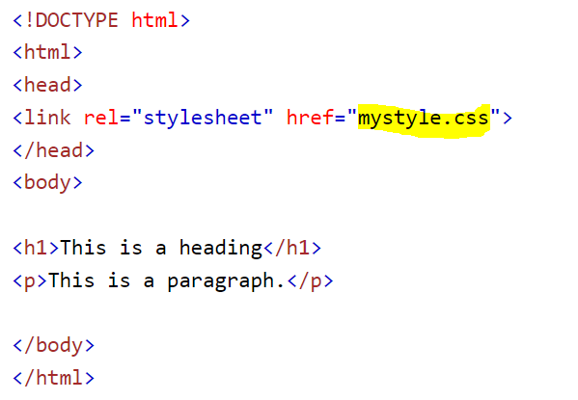
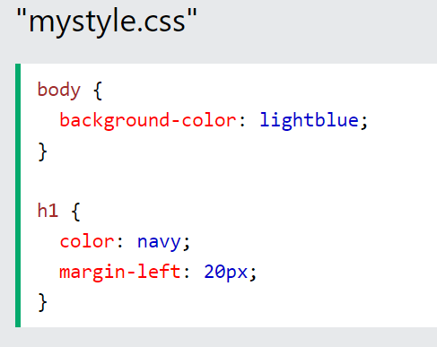
External CSS
With an external style sheet, you can change look of entire website by changing just one file. Provide reference to external CSS in HTML <link> inside head section.

Slide 93
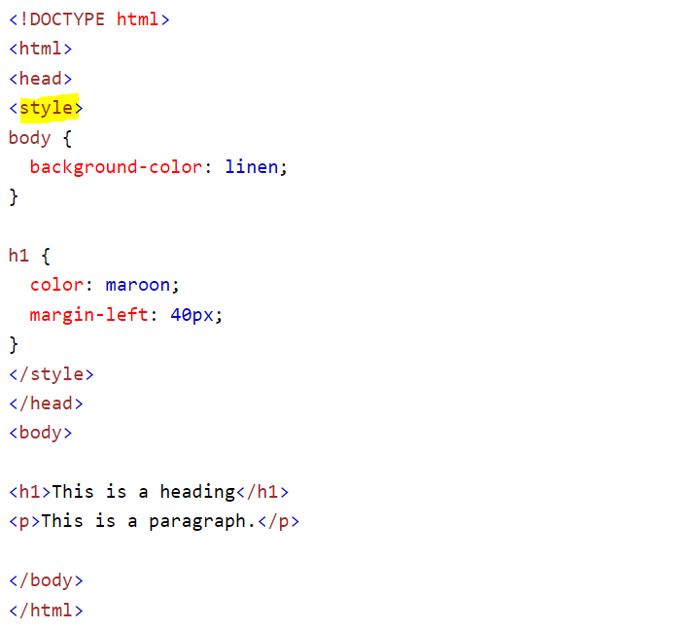
Internal CSS
Internal Style Sheet may be used if one single HTML page has unique style. It is defined inside the <style> elements, inside head section.

Slide 94
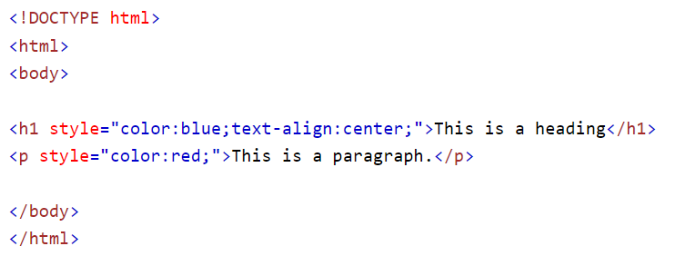
Inline CSS
An Inline Style may be used to apply a unique style for a single element. Add style attribute to the relevant element. It can contain any CSS property.

Slide 95
Cascading Order in CSS
Cascading order means which style will be used when more than one specified for any HTML element. Below is the virtual style sheet following the rules as below:
Inline style (inside an HTML element)
External and Internal style sheets (in the head section)
Browser Default Inline Style has the highest priority and will override all other styles

Slide 96
What is CSS? CSS Syntax How to Add CSS Cascading Order Why use CSS?Demonstration of CSS
Review

Slide 97
Quiz Time
https://forms.gle/XU7e7r75yFoDMPmR8

Slide 98
DIY
Keep Learning, Keep Exploring

Slide 99
CSS Selectors & Combinators

Slide 100
What are Selectors?
Different types of Selectors Usage of Each Selector with Example
CSS Combinators
CSS Pseudo-class
CSS Pseudo-element
Overview

Slide 101
What are Selectors?
CSS Selectors are used to “find” the HTML element you want to style.
You can select multiple HTML elements by different ways using selectors.

Slide 102
Types of Selectors
Simple Selectors (Select based on name, id, class)
Combinator Selectors (Select based on specific relationship)
Pseudo-class Selectors (Select based on certain state)
Pseudo-element Selectors (Select and style a part of element)
Attribute Selectors (Select based on attribute or attribute value)

Slide 103
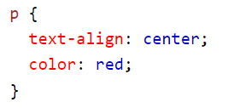
CSS element Selector
Select based on HTML element name.

Slide 104
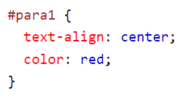
CSS ID Selector
Uses the ID attribute of an HTML element
id of an element should be unique
use # character to select an element.

Slide 105
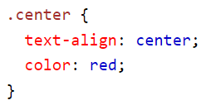
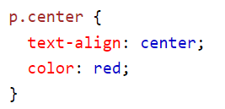
CSS Class Selector
Select elements with a specified class attribute
use . (period) character to select an element.

Slide 106
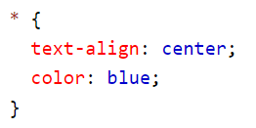
CSS Universal Selector
Select all elements on the page
(*) is the universal selector.

Slide 107
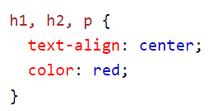
CSS Grouping Selector
Select All elements with same style definitions
To group selectors, separate with comma.

Slide 108
CSS Combinators
A combination is something that explains the relationship between the selectors
A CSS selector can contain more than one simple selector. We can include a combinator between them.
4 different Combinators in CSS ->
Descendant selector (space)
Child selector (>)
Adjacent sibling selector (+)
General sibling selector (~)

Slide 109
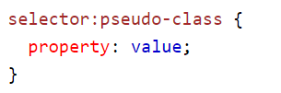
CSS Pseudo-class
Pseudo-class is defined as special state of an element.
For instance, It can be used to:
Style an element when a user mouses over it
Style visited and unvisited links differently
Style an element when it gets focus

Slide 110
Pseudo classes
Anchor Pseudo classes
Pseudo classes with HTML classes
hover div
:first-child
:lang
:focus

Slide 111
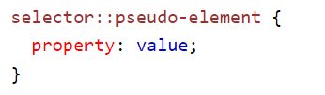
CSS Pseudo-element
Pseudo-element is used to style specified parts of an element
For instance, It can be used to:
Style first letter, or line, of an element.
Insert content before, or after, the content of an element.

Slide 112
Pseudo Elements
::first-line
::first-letter
Pseudo elements with HTML classes
Multiple Pseudo elements
::before
::after
::marker
::selection

Slide 113
What are Selectors? Different types of Selectors Usage of Each Selector with Example CSS Combinators CSS Pseudo-class CSS Pseudo-element
Review

Slide 114
Quiz Time
https://forms.gle/nKTa4QLVtrNR6BnY8

Slide 115
DIY
Keep Learning, Keep Exploring

Slide 116
CSS Positioning & Typography - I

Slide 117
CSS Units
Absolute Lengths Relative Lengths Important Tips for CSS Units
Styling Text with CSS -Word-wrap and overflow-wrap
Boxes Position in View Port
Overview

Slide 118
CSS Units
CSS has several different units for expressing a length.
Many CSS properties take length values, such as width, margin, padding, font-size etc.
Length is a number followed by length unit such as 10px, 2em.
A white space cannot appear between the number and the unit.
If the value is 0, the unit can be omitted.
For some CSS properties, negative lengths are allowed.

Slide 119
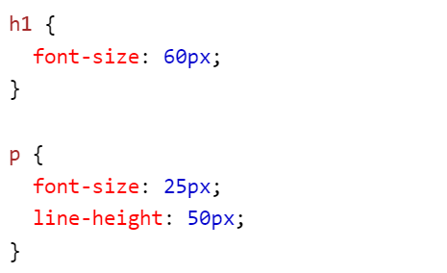
CSS Units
Here, we have specified the font size of heading 1 as 60px where px is length unit and 60 is length value.
Similarly, we did for Paragraph tag with line height

Slide 120
Absolute Lengths
The absolute lengths units are fixed, and a length expressed in any of these will appear as exactly that size.
They are not recommended for use on screen.
However, they can be used if output medium is known, such as for print layout.
Few Examples are: cm (centimeters), mm(millimeters), px(pixels), in(inches), pt (points)

Slide 121
Relative Lengths
Relative length units specify a length relative to another length property.
These units scale better between different rendering mediums.
Few Examples are: em – Relative to font-size of the element rem – Relative to font-size of root element vh/vw – Relative to 1% of height/width of the viewport % - Relative to parent element

Slide 122
Important Tips for CSS Units
Pixels(px) are relative to viewing device.
em and rem units are practical in creating perfectly scalable layout.
Viewport = Browser size. If the viewport is 50cm wide, then 1vw = 0.5 cm.

Slide 123
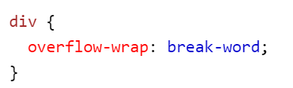
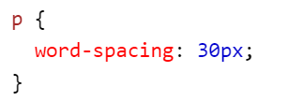
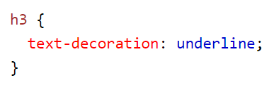
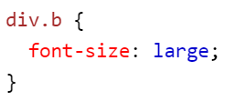
Styling Texts with CSS
There are lot of CSS properties which can be used to style text values includes font-size, text-color, overflow-wrap, word-wrap etc.
We can use common and all at once for styling different Props.

Slide 124
Boxes position in Viewport
A Viewport represents the area in computer graphics being currently viewed. Its sizes are mutable.
Positioning allow you to take elements out of normal document flow and make them behave differently.
There are number of different types of positioning that you can put into effect on HTML elements.
This can be achieved using the CSS property position which allows to use values like static, relative etc,

Slide 125
CSS Units Absolute Lengths Relative Lengths Important Tips for CSS Units Styling Text with CSS -Word-wrap and overflow-wrap Boxes Position in View Port
Review

Slide 126
Quiz Time
https://forms.gle/KvbSFiPD7sg1rTWP8

Slide 127
DIY
Keep Learning, Keep Exploring

Slide 128
CSS Positioning & Typography - II

Slide 129
Position property
Different offset properties Visual Representation Z-index property Overflow Property Width, max-width and margin
Overview

Slide 130
Position Property
Position Property specifies the type of positioning method used for element
Elements are positioned using offset properties with position value,
Different Position values are:
sticky
relative
Fixed
Absolute
static

Slide 131
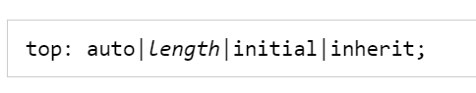
Different Off Set Properties
There are 4 offset properties present – top, bottom, right, left.
These properties are being used with position property to provide the container a perfect position to the container.
Syntax of off Set Properties:

Slide 132
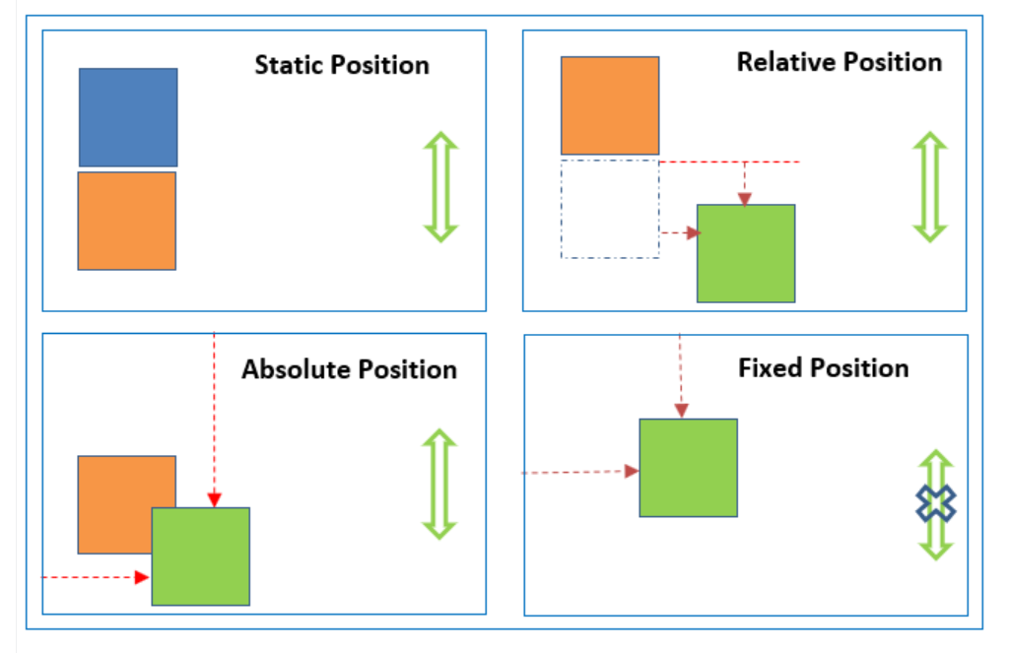
Visual Representation

Slide 133
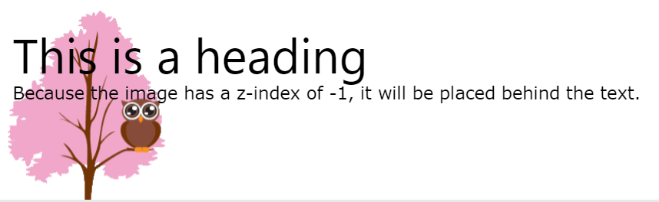
Z-index property
z-index property specifies the stack order of the element.
When elements are positioned, they can overlap with elements and their z-index comes into picture.
An element can have positive or negative stack order.
z-index only works on positioned elements.

Slide 134
Overflow Property
The CSS overflow property controls what happens to content that is too big to fit into an area.
It specifies whether to clip the content or to add scrollbars
Overflow property has following values: visible – overflow is not clipped. hidden – overflow content will be invisible scroll – scrollbar is added to see the rest of the content auto – it will add scroll bar only if necessary.

Slide 135
Width and max-width property
Setting the width of block level element will prevent it from stretching out to the edges of its container.
Setting the margin to auto to horizontally center the element.
Using max-width instead, it will improve the handling of small windows.

Slide 136
Position property Different offset properties Visual Representation Z-index property Overflow Property Width, max-width and margin
Review

Slide 137
Quiz Time
https://forms.gle/dwGwcVTRm76UcVL67

Slide 138
DIY
Keep Learning, Keep Exploring

Slide 139
Introduction to Bootstrap

Slide 140
What is Bootstrap?
Why use Bootstrap? Bootstrap Versions
Syntax of Bootstrap Connecting Bootstrap in Page Container and Container Fluid My First Bootstrap Page
Overview

Slide 141
What is Bootstrap?
Bootstrap is a free front-end framework for faster and easier web development.
It includes HTML and CSS based design templates for typography, forms, buttons, tables, navigations, modal and many other.
It also gives you the ability to easily create responsive designs.

Slide 142
Advantages of Bootstrap
Easy to Use: Anyone can use Bootstrap with basic knowledge of HTML and CSS.
Responsive Features: Its responsive CSS adjusts to phones, tablets and Desktops.
Mobile First Approach: In Bootstrap, mobile-first styles are part of core framework.
Browser Compatibility: It is compatible with all modern browsers.

Slide 143
Bootstrap Versions
Bootstrap 3 – Released in 2013
Bootstrap 4 – Released in 2018
Bootstrap 5 – Released in 2021 Bootstrap 5 has switched to Javascript instead of Jquery.

Slide 144

Syntax of Bootstrap

Slide 145

How to connect Bootstrap to Page
One can include it from CDN (Content Delivery Network). It provides support for Bootstrap’s CSS and JS.

Slide 146


Container
Containers are used to pad the content inside of them.
.container is the class used for responsive fixed width container.
Its max-width change on different screen sizes.

Slide 147

Container Fluid
.container-fluid class is used to create a full width container.
It will always span the entire width of the screen.
width is always 100%

Slide 148



My First Bootstrap Web page
Include HTML5 doctype, adding meta info, using container classes

Slide 149
What is Bootstrap? Why use Bootstrap? Bootstrap Versions Syntax of Bootstrap Connecting Bootstrap in Page Container and Container Fluid My First Bootstrap Page
Review

Slide 150
Quiz Time
https://forms.gle/FsFGt7hvtvR5esGE8

Slide 151
DIY
Keep Learning, Keep Exploring

Slide 152

Bootstrap Components

Slide 153

Jumbotron
Button Grid Table Form Alert Wells
Overview
More than 30 Million downloads

Slide 154


Jumbotron Component
It indicates a big grey box for calling extra attention to some special content or information.
You can put nearly any valid HTML element inside Jumbotron
Full width Jumbotron without rounded borders, we can use
.jumbotron-fluid class and .container class inside of it.

Slide 155
Button Component
Bootstrap provides different styles of buttons like Basic, Primary, Secondary, Success, Info, Warning, Danger, Dark, Light, Link.
The button classes can be used on <a>, <button> or <input> elements.
It also provides 8 outline/bordered buttons.
It also have Button sizes like large and small.
It also have block level buttons that spans the entire width.
It also provides spinner buttons option to add spinners in button

Slide 156



Button Component

Slide 157
Grid Component
BS Grid system is built with flexbox and allows 12 columns across the page
It is responsive and the column will rearrange automatically. The Bootstrap grid system has five classes:
.col- (Extra small devices – screen width less than 576px)
.col-sm- (Small Devices – screen width >= 576px)
.col-mg- (Medium Devices – screen width >= 768px)
.col-lg- (Large Devices – screen width >= 992px)
.col-xl- (Extra Large Devices – screen width >= 1200px)

Slide 158


Basic Structure of Grid Layout
The sum adds up to 12 or fewer.

Slide 159
Grid Component Variations
Responsive Columns
Two Unequal Responsive Columns
Three Equal Columns

Slide 160
Table Component
Basic Table: It has light padding and horizontal dividers. (.table)
Striped Rows: It adds Zebra-Stripes in table (.table-striped)
Bordered Table: Add borders on all sides of table (.table-bordered)
Hover Rows: It adds a hover effect on rows (.table-hover)
Dark Table: It adds black bg to table (.table-dark)
Borderless Table: It removes borders in table (.table-borderless)
Contextual Classes: Used to color the whole table, rows and
Columns.
Table Head: Adds black bg to table headers (.thead-dark)

Slide 161

Form Component
Form controls automatically receive some global styling with BS.
All elements with class .form-control have a width of 100%. BS provides 2 types of form layouts:
Stack Layout: It provides full width form

Slide 162
Form Component
Inline Form: All the elements are inline and left-aligned. Add class .form-inline to the <form> element
Form Row/Grid: Use .col to control width and alignment.

Slide 163
Alert Component
BS provides easy way to create predefined alert messages.
Alerts are created with .alert class, followed by contextual classes .alert-success, .alert-info, .alert-warning etc.
Add the alert-link class to any links inside alert box for colored matching links.
To close the alert message, add a .alert-dismissible class to the alert container. Then add “class=“close” and data-dismiss=“alert”
The .fade and .show classes adds a fading effect when closing.

Slide 164

Wells Component
well class adds a rounded border around an element with a grey background color and some padding.
Change the size of well by adding the .well-sm and .well-lg.

Slide 165
Jumbotron Button Grid Table Form Alert Wells
Review

Slide 166
Quiz Time
https://forms.gle/6ZRz6A19Qd4oxTSb9

Slide 167

DIY
Keep Learning, Keep Exploring

Slide 168
Bootstrap Components Part-II

Slide 169
Bootstrap Badges/Labels
Pager and Pagination
Bootstrap Images Bootstrap Images List Groups Dropdowns
Overview
Panels
Carousel
Glyphicons

Slide 170


Bootstrap Badges
Badges are numerical indicators of how many items are associated. The number (5, 10 and 2) are badges.
Use .badge class within <span> element to create badges
Badges can also be used inside other elements, such as buttons:

Slide 171

Bootstrap Labels
Labels are used to provide some additional information about something
Use .label class followed by one of the six contextual classes like .label-default, .label-primary, .label-success etc.
Following shows all contextual label classes:

Slide 172



Bootstrap Pagination
For more pages, we wish to add some sort of pagination to each page
A basic pagination in Bootstrap looks like:
Add .pagination class to an <ul> element.
.active will let the user know which page he/she is on: A disabled link can not be clicked. Add .disabled class

Slide 173

Bootstrap Pagination
Pagination blocks can also be sized to larger size or smaller size.
.pagination-lg and .pagination-sm for larger and smaller blocks.
Breadcrumbs is another form of Pagination
.breadcrumb class indicates the current page’s location within a navigational hierarchy. Where vacation is active location in breadcrumb pagination.

Slide 174

Bootstrap Pagers
Pager is also form of Pagination. It provides previous and next buttons
To create previous/next buttons, add the .pager class to <ul> element.
Use the .previous and .next classes to align each button to the sides of the page.

Slide 175

Bootstrap Images
With bootstrap, you can specify the shapes of the images.
.img-rounded adds rounded corners to an image.
.img-circle shapes the image to the circle.
.img-thumbnail shapes the image to the thumbnail. You can also add .img-responsive class to <img> tag. The image will scale nicely to the parent element.

Slide 176


Bootstrap Progress Bar
A progress bar can be used to show a user how far along he/she in a process.
To create a default Progress bar, add .progress class to <div>
Remove the .sr-only class from the progress bar to show a %age.

Slide 177

Progress Bar
Contextual Classes are used to provide “meaning through colors”
.progress-bar-success, .progress-bar-info contextual classes can be used to provide colors to Progress.
.progress-bar-striped to add stripes to progress bar.
.active to use the animated progress bar. Stacked progress can be created using <div class=“progress”>

Slide 178
Bootstrap List Groups
To create a basic list-group, use an <ul> element with class .list-group, and <li> with class .list-group-item.
You can also add badges to a list group. Create <span> element with class .badge inside list item.
To create a list group with linked items, use <div> instead of <ul> and <a> instead of <li>.
.active to highlight the current item
.disabled class to disable an item.
Contextual Classes can be used to color list items. (.list-group-item-success, .list-group-item-info)

Slide 179
Bootstrap Dropdowns
A dropdown menu is toggleable menu that allows the user to choose one value from a predefined list.
.dropdown class indicates a menu.
To open a dropdown, use a button or link with a class of .dropdown-toggle and the data-toggle=“dropdown” attribute.
.caret class creates a caret arrow icon which indicates dropdown.
Add a .dropdown-menu class to <ul> element to bind the dropdown menu.
.divider class is used to separate links inside the dropdown menu with horizontal border.

Slide 180


Bootstrap Dropdowns
The .dropdown-header class is used to add headers inside the dropdown menu.
.disabled and .active class to show active and disable items.
To right align the position of dropdown menu, use .dropdown-menu-right class to <ul> element.

Slide 181
Bootstrap Panels
A panel in a bootstrap is a bordered box with some padding around its content.
.panel class, and content inside the panel has a .panel-body class.
.panel-heading class adds the heading to the panel.
.panel-footer class adds the footer to the panel.
To group many panel, wrap a <div> with class .panel-group around them.
Panels with Contextual classes using .panel-success, .panel-info, .panel-warning.

Slide 182

Bootstrap Carousel
A Carousel Plugin is a component for cycling through elements.
The class .carousel specifies that the <div> contains a carousel.
.slide class adds a CSS transition and animation effect.
data-ride=“carousel” tells BS to begin the animating the carousel.

Slide 183


Bootstrap Glyphicons
Bootstrap provides 260 glycphicons from the set.
It can be used in text, buttons, toolbars, navigations, forms etc.
Syntax of Glyphicon in HTML

Slide 184
Bootstrap Badges/Labels Pager and Pagination Bootstrap Images Progress Bar List Groups Dropdowns
Review
Panels
Carousel
Glyphicons

Slide 185
Quiz Time
https://forms.gle/jjDiJcZFxzaLbHYt9

Slide 186
DIY
Keep Learning, Keep Exploring

Slide 187
Advanced Bootstrap Components

Slide 188
Tabs/Pills
Navbar Input Types
Bootstrap Modals Popovers
Overview
Tooltips Scrollspy
Bootstrap Utilities

Slide 189


Bootstrap Tabs
Tabs are special case of HTML menus.
It is created with <ul class=“nav nav-tabs”>
We need to mark the current page with <li class=“active”>
Tabs can have dropdown menus as well.

Slide 190
Bootstrap Pills
Pills are special navigation menu used in the web pages.
It is created with <ul class=“nav nav-pills”>
It should mark the current page with <li class=“active”>
nav-stacked will add the vertical pill lists.
To center/justify the tabs/pills use .nav-justified class.

Slide 191

Toggleable Tabs/Pills
To make Tabs/Pills toggleable, add the data-toggle=“tab/pill” attribute to each link.
Add a tab-pane class with unique id for every tab/pill and wrap them inside <div> with class tab-content. Use .fade to tab-pane to have fade in fade out effect.

Slide 192
Navbar
Navigation bar is a nav header that is placed at the top of the page.
A standard navigation bar is created with <nav class=“navbar navbar-default”>
Black navbar can be used with class .navbar-inverse instead of default.
Different types of Navbars:
Navigation bar with Dropdown
Right Aligned Navigation Bar (.navbar-right)
Navbar Button, text and forms (.navbar-text/btn/form)
Fixed Navigation Bar (.navbar-fixed-bottom/top)

Slide 193
Input Types
input
textarea
checkbox and radio (.checkbox and .radio)
Select
Bootstrap supports following form controls:
Inputs will not be styled properly if their types are not properly declared. BS supports all HTML5 input types like text, password, number, email, week etc.

Slide 194
Bootstrap Modals
A modal plugin is a dialog box/popup window that is displayed on top of the current page.
To create a modal, you need a trigger which will open the modal, a modal part and the content which is to be displayed.
Add the size class to the div with class .modal-dialog. Use .modal-sm and .modal-lg for smaller and larger modals

Slide 195

A Simple Modal Page

Slide 196


Tooltips
A tooltip plugin is small pop-up box that appears when the user moves the mouse pointer over an element.
To create a tooltip, add the data-toggle=“tooltip” attribute.
Add the title attribute to specify the text that should be displayed inside the tooltip.
Positioning Tooltip, Use the data-placement attribute to set the position of the tooltip on top, bottom, left and right.

Slide 197


Popover
A popover plugin is like tooltip. It appears when user clicks on an element.
To create a popover, add the data-toggle=“popover” attribute.
Add the title attribute to specify the header text and use data-content to specify the text displayed inside the popover body.
Use data-trigger=“focus” to close the popover on clicking
outside.

Slide 198

Scrollspy
A scrollspy plugin is used to automatically update links in a navigation list based on scroll position.
Scroll can be horizontal or vertical depending on the implementation..

Slide 199

A simple Scroll Spy Page

Slide 200
A simple Scroll Spy Page

Slide 201
Bootstrap Utilities
Bootstrap 4 has a lot of utility/helper classes to quickly style elements without using any CSS code.

Slide 202



Border
Use the border classes to add or remove borders from an element.
Add a color to the border with any of the contextual border classes.
Add rounded corners to an element with the rounded classes.

Slide 203

Float and Clearfix
Float an element on right with .float-right class and to the left with .float-left class.
Clear floats with .clearfix class.
Responsive floats – Use responsive float classes depending on the screen size.

Slide 204


Centre Align and Width
Center an element with the .mx-auto class (adds margin left and margin right auto).
Set the width of the element with the w-* classes. (w-25, w-50, w-75)
Set the height of the element with the h-* classes. (h-25, h-50, h-75)

Slide 205



Spacing
Bootstrap has wide range of responsive margin and padding utility classes.
The classes are used in the format {property}-{sides}-{size} for xs device and {property}-{sides}-{breakpoint}-{size} for all other devices.
where Property is:
where Sides are:
where size is:

Slide 206



Shadows and visibility
Use the shadow- class to add shadows to an element.
Use the align- class to change the alignment of elements.
Use .visible and .invisible to control the visibility of the elements.

Slide 207
Colors and Background Colors
The classes for text-colors are : text-muted, text-primary, text-success, text-info, text-warning, text-danger, text-secondary, text-white, text-dark, text-body
Contextual classes can also be used on links, which will add a darker hover color.
You can also add 50% opacity for black or white text with the .text-black-50 or .text-white-50.
Classes for Background colors are : .bg-primary, .bg-secondary, .bg-info,
.bg-success, .bg-warning, .bg-danger, .bg-dark, .bg-light
Note: Background colors do not set the text color, so in some cases you
Have to use them with text- class.

Slide 208
Close Icon and Screen Reader
Use the .close class to style a close icon. It is often used for alerts and modals.
We use the &times; symbol to create the actual icon. It floats right by default.
Use the .sr-only class to hide an element on all devices, except screen readers.

Slide 209
Typography Text Classes
All text typography classes are there.
font-weight-bold, font-weight-bolder, font-weight-normal, font-weight-lighter
Font-italic, text-break, text-center, text-left, text-decoration-none, text-justify,
Text-lowercase, text-right, text-nowrap, text-uppercase, text-capitalize, pre-scrollable

Slide 210
Tabs/Pills Navbar Input Types Bootstrap Modals Popovers
Review
Tooltips Scrollspy
Bootstrap Utilities

Slide 211
Quiz Time
https://forms.gle/WAXagadJi9tc5EZx5

Slide 212
DIY
Keep Learning, Keep Exploring

Slide 213
Introduction to Javascript

Slide 214
Introduction to JS
JS Outputs JS Comments
JS Variables JS Operators JS Data Types JS Functions
Overview

Slide 215
Introduction to Javascript
Javascript is the most popular Programming Language. It is programming language of Web.
JS can change HTML content and HTML Attribute Values.
JS can change HTML Styles (CSS) and Hide/Show elements.
Commonly Used JS Method is getElementById()
Javascript accepts both single and double quotes
JS code is inserted between <script> and </script> tags.
It can be placed in external files as well with .js extension

Slide 216

Advantages of External JS
It separates HTML and code.
It makes HTML and JS easy to maintain.
Cached JS files can speed up page loads.
An external Script can be referenced in 3 ways

Slide 217
JS Outputs
Javascript displays data in different ways.
Writing into HTML content using innerHTML
Writing into HTML output using document.write()
Writing into an alert box using window.alert()
Writing into the browser console using console.log()

Slide 218


JS Comments
Javascript comments can be used to explain JS code, and to make it more readable.
It can also be used to prevent execution when testing alternate code.
Single line comments starts with //
Multi Line comments starts with /* and end with */

Slide 219




JS Variables
Variables are container for storing data. It can be declared in 4 ways.
Automatically, var, let, const.
It is always a good programming practice to always declare variables. Just Like Algebra, Variables holds values and used in expresssions.

Slide 220
When to use var, let and const
Always declare variables.
Always use const if the value should not be changed.
Always use const if the type should not be changed.
Only use let if you can’t use the const.
Only use var if you MUST support old browsers.

Slide 221
JS Identifiers
All JS variables must be identified with unique names which are known as identifiers.
It can be short name (x, y, z) or descriptive names (sum, name).
Rules for constructing names for variables (unique) are:
It can contain letter, number, underscore and dollar
It should begin with letter or $ or _.
Names are case sensitive.
Reserved words can not be used as names.

Slide 222
JS let and const
let/const keyword was introduced in 2015 (ES6)
let/const cannot be redeclared.
let/const must be declared before use
let/const have block scope
const cannot be reassigned but let can be reassigned.
Variables declared inside { } cannot be accessed outside the block
Variables declared with var keyword can not have BLOCK scope.

Slide 223

Difference between var, let and const

Slide 224
JS Operators
Arithmetic Operators
Assignment Operators
Comparison operators
String operators
Logical and Bitwise Operators
Ternary Operators
Type Operators

Slide 225


Arithmetic and Assignment operators

Slide 226

Comparison and Ternary Operators

Slide 227



Logical, Bitwise and Type Operators

Slide 228


JS Data Types
To be able to operate on variables, it is important to know about type.
JS evaluates expression from left to right.
JS types are dynamic means same variable can be used to hold different data types.
Data Types present in JS are:

Slide 229

JS Functions
Function is a block of code designed to perform particular task.
It executes if something calls (invokes) it.
JS function is defined with the function keyword, followed by name, followed by parentheses {}.
The parentheses may include param names separated by comma

Slide 230

JS Functions
Code inside the function will execute when something invokes it.
It often compute a return value. Its return value is returned back to caller
You can reuse code with functions which can be used many times.
you can use the same code with different arguments, to produce results.

Slide 231
Introduction to JS JS Outputs JS Comments JS Variables JS Operators JS Data Types JS Functions
Review

Slide 232
Quiz Time
https://forms.gle/eyiuxk7b9R8pRes59

Slide 233
DIY
Keep Learning, Keep Exploring

Slide 234
Javascript Control Flow

Slide 235
Conditional Statements
If & else Statements Switch case
JS loops Different kinds of Loops JS Loop For in and For of break and continue
Overview

Slide 236
Conditional Statements
Conditional Statements are used to perform different actions based on different conditions.
In JS, we have following Conditional Statements:
Use “if” to specify a block to execute if specific condition is true.
Use “else” to specify a block to execute if same condition is false
Use “else if” to specify a new condition to test, if first condition
Is false.
Use “switch” to specify many alternate blocks to be executed.

Slide 237



If & else Statements
if and else statements are in lower case otherwise it will give errors..

Slide 238

Switch Case
switch statement is used to perform different actions based on different conditions
break keyword is used to break out of switch condition. It will stop the execution inside switch block.
default keyword specifies the code to run if there is no case match.

Slide 239

JS Loops
Loops can execute a block of code a number of times.
Loops are handy, if you want to execute the same code over and over again, with different value.
This piece of code will append the cars array values one by one
Using the loop.

Slide 240
Different kinds of Loop
for – loops through a block of code number of times.
while – loops through a block of code while a specified condition is true
do/while – also loops through a block of code while a specified condition is true.

Slide 241



For Loop
for statement creates a loop with 3 optional expressions..

Slide 242


While Loop
While Loop loops through a block of code as long as a specified condition is true.

Slide 243


Do While Loop
Do while loop is the variant of the while loop. This loop will execute the code block once, before checking if the condition is true

Slide 244


For in Loop
The Javascript for in statement loops through the properties of an Object and Array Do not use for in over an Array if the index order is important.

Slide 245


For of Loop
Javascript for of statement loops through the values of an iterable Object. It lets you loop over iterable data structures like Array, String, Map etc.

Slide 246


Break and continue
Break statement jumps out of a loop.
Continue statement jumps over the iteration in the loop.

Slide 247
Conditional Statements If & else Statements Switch case JS loops Different kinds of Loops JS Loop For in and For of break and continue
Review

Slide 248
Quiz Time
https://forms.gle/3rnSr6YkU4QxMcsV9

Slide 249
DIY
Keep Learning, Keep Exploring

Slide 250
Javascript Arrays

Slide 251
Introduction to Arrays
Creating an array Accessing Array Elements
Array Methods Array Sorting Array Iteration
Overview

Slide 252
Introduction to Arrays
An array is special variable, which can hold more than one value.
It can hold many values under single name, and you can access the values by referring to an index number.
Arrays are generally used when you have a list of items which you want to loop and access each one by one.

Slide 253

Creating an Array
Using an Array Literal
Create an Array and then provide the elements.
Using the Javascript keyword new
For simplicity, readability and execution speed, use the array literal method.

Slide 254




Array Elements
You can access an array elements by referring to index number.
You can change the array element value by using index value.
JS method toString() converts an array to string of array values.

Slide 255



Array Elements
In Javascript, full array can be accessed by referring to the array name.
Accessing the First Array Element.
Accessing the Last Array Element

Slide 256

How to Recognize an Array
Javascript array is an object. Operator typeof returns “Object”. To Solve this problem there are 2 ways to recognize an array.
Using ES5 Method Array.isArray(arrayName):
Using instanceof Operator if an object is created by given constructor.

Slide 257



Array Methods
JS Array length – It returns the length of an array
JS Array join() – Join all array elements into a string

Slide 258


Popping and Pushing
JS Array pop() – It removes the last element from an array. It also returns the value that was “popped out”
JS Array push() – It adds a new element to an array. It also returns the new array length.

Slide 259


Shifting Elements
JS Array shift() – It removes the first array element and “shifts” all other elements to a lower index. It returns the value that is shifted out.
JS Array unshift() – It adds a new element to an array at the beginning. It also returns the new array length.

Slide 260



Merging & Flattening Array
JS Array concat() – creates a new array by merging existing arrays. It does not change the existing arrays.
It always returns a new array. It can take any number of arguments.
flat() – creates a new array with sub-array concatenated.

Slide 261

Splicing Array
JS Array splice() – It can be used to add new items to an array. It returns array with the deleted items.
The first param defines the position where new element to add. The second param defines how many elements to remove Rest of the params define the new elements to be added.

Slide 262
Slicing Array
JS Array slice() – It can be used to slice out a piece of array into a new array. It creates a new array. It does not remove any elements from a source array.
It selects elements from the start argument and up to the end argument (not including).

Slide 263


Array Sorting
sort() method sorts an array alphabetically.
reverse() method reverse the elements in an array.
Numeric Sort: By default, sort() function sorts values as Strings. If we use sort() on numbers, it will give incorrect result. This can be fixed by providing the compare function.

Slide 264


Array Sorting
Sort Numbers in Ascending Order with compare function
Sort Numbers in Descending Order with compare Function.
Compare Function – It returns negative, zero or positive value. If result is negative, a is sorted before b. If result is positive, b is sorted before a. In case of 0, no change in the sorting order of the elements.

Slide 265




Array Iteration
JS Array forEach() method – It calls once for each array element.
JS Array map() – creates new array by performing a function.

Slide 266



Array Iteration
JS Array flatMap() method – It maps all elements the create new array
JS Array filter() – creates new array with elements that pass a test.

Slide 267




Array Iteration
JS Array reduce() method – It runs a fn on each element to produce a single value
JS Array every() – Checks if all array values pass a test.

Slide 268


Array Iteration
JS Array some() – It Checks if some array values pass a test
JS Array find() – returns first element that passes a test function

Slide 269


Other Important Methods
JS Array includes() – It Checks if element is present in an array or not.
JS Array findIndex() – returns index of first element that passes a test function

Slide 270


Indexing Methods
JS Array indexOf() – It search an array for an element value and returns position.
JS Array lastIndexOf() – returns position of last occurrence of specified element.

Slide 271
Introduction to Arrays Creating an array Accessing Array Elements Array Methods Array Sorting Array Iteration
Review

Slide 272
Quiz Time
https://forms.gle/jkZXrRJYqbMNMpZr7

Slide 273
DIY
Keep Learning, Keep Exploring

Slide 274
Javascript Objects – Part I

Slide 275
What is OOP
This keyword
Constructor & Constructor Functions Constructor Property Factory & Factory Functions Dynamic Nature of Objects Functions & Objects
Overview

Slide 276
What is OOP?
OOP Is Object Oriented Programming.
In Javascript, almost “everything” is an object. All JS values except primitives are objects.
Objects are variables. It can contain multiple values.
Objects are written as name: value pairs. (separated by colon)
Object is a unique entity that contains properties and methods.
A Method in Javascript is a property of an object whose value
Is a function.

Slide 277

JS Objects
Object can be created in 2 ways – Object Literal and Object Constructor
Object Literal – Define and Create Object in One Statement.
Using Javascript New Keyword.

Slide 278

JS Objects
JS Objects are mutable. They are addressed by reference and not by value.
The object x is not a copy of object person. It is person only.
Any changes to x will change the person object as well.

Slide 279
This keyword
In Javascript, this keyword refers to an object.
this keyword refers to different objects depending on how it is used :
In an Object method, this refers to the object.
Alone, this refers to the global object
In a function, this refers to the global object.
IN an event, this refers to the elements that received the event.
Methods like call(), bind() and apply() can refer this to any obj.
In a function, in strict mode, this is undefined.

Slide 280


Constructor Functions
Sometimes, we need a blueprint for creating many objects of the same type. The way to create an object type is to use Constructor Functions.
Object of same type are called by calling the constructor function with new keyword.
In constructor function, this does not have value.
Always name a constructor function with upper case first letter.

Slide 281



Constructor and its usage
Adding a Property to an object.
Adding a Method to an object.
Adding a property to Constructor

Slide 282

Constructor and its usage
Adding a method to the constructor

Slide 283
Factory Functions
A Factory function is a function that creates an object and returns it.
This function do not require “this” keyword for inner values. Also, they do not need “new” keyword when initiating objects.
They are mainly used when the user wants to initialize the object of the class multiple times with some assigned values or static value.
It makes the process easy as we have to call the function and
retrieve the new object created.

Slide 284

Factory Functions Example - 1

Slide 285

Factory Functions Example - 2

Slide 286
Dynamic Nature of Objects
You can choose dynamic values or variable names and objects in future without accessing the object/array.
There are several methods can be used to create dynamic values and objects in Javascript.
Using Object Literals with computed property names.
Using the bracket notation for object property assignment.
Using the spread operator.

Slide 287



Examples to show Dynamic Addition

Slide 288


Functions & Objects
Javascript methods are actions that can be performed on the objects.
A Javascript method is property containing a function definition.
You can access the object method with the following way:
You can also use inbuilt methods like:

Slide 289
What is OOP this keyword Constructor & Constructor Functions Constructor Property Factory & Factory Functions Dynamic Nature of Objects Functions & Objects
Review

Slide 290
Quiz Time
https://forms.gle/Kr5ijdgcgguZ7AGJA

Slide 291
DIY
Keep Learning, Keep Exploring

Slide 292
Functions

Slide 293
Function Declaration & Expression Hoisting
Arguments Rest Operator Try & Catch Block this keyword JS Changing this
Overview

Slide 294

Function Declaration
It declares the function with function keyword. It must have function name.
It does not require a variable assignment as they are standalone constructs and cannot be nested inside a functional block.
These are executed before any other code.
It can be accessed before or after the function definition.

Slide 295

Function Expression
It is similar to function declaration without the function name.
It can be stored in a variable assignment.
Function expressions load and execute only when the program interpreter reaches the line of code.
It can be accessed only after the function definition.

Slide 296


Hoisting
Hoisting is Javascript Default behavior of moving declarations at top
In JS, a variable can be declared after it has been used.
Hoisting moves all the declarations at the top of the current scope.
Variables defined with let and const are hoisted at the top of the block.

Slide 297

Hoisting
JS only hoists declarations and not initializations.
Always declare all variables at the beginning of every scope.
JS in strict mode does not allow variables to be used if they are not declared.

Slide 298
Function Arguments
Function parameters are the names listed in the function definition.
Function arguments are the real values passed to the function.
JS function definitions do not specify data types for parameters.
JS functions do not perform type checking on the passed arguments
JS functions do not check the number of arguments passed.

Slide 299


Default and Missing Parameters
If a function is called with missing arguments, then missing values set to undefined.
ES6 allows the function parameters to have default values.

Slide 300

Rest Operator
Rest Parameter (…) allows a function to treat an indefinite number of arguments as an array.

Slide 301

JS Errors
The try statement defines a code block to run (to try)
The catch statement defines a code block to handle any error.
The finally statement defines a code block to run regardless of result.
The throw statement defines a custom error.
When an error occurs, JS will stop and generate an error message.

Slide 302

The throw statement
The throw statement allow you to create a custom error.
Technically, you can throw an exception (throw an error)
The exception can be JS String, Number, Boolean or Object.

Slide 303

The finally statement
The finally statement lets you execute the code, after try and catch, regardless of the result.

Slide 304


This keyword
In a function, the global object is the default binding for this.
JS strict mode does not allow default binding.
In strict mode, this is undefined..

Slide 305

Call()
With the call() method, you can write a method that can be used on different objects.
It can be used to invoke a method with an owner object as an argument

Slide 306

apply()
With the apply() method, you can write a method that can be used on different objects.
It is similar to call() but difference is it takes argument as an array while call() takes argument separately.

Slide 307

bind()
With the bind() method, an object can borrow a method from another obj
the member object borrows the full name method from person object.

Slide 308
Function Declaration & Expression Hoisting Arguments Rest Operator Try & Catch Block this keyword JS Changing this
Review

Slide 309
Quiz Time
https://forms.gle/ziLWj94Ss31rucQE9

Slide 310
DIY
Keep Learning, Keep Exploring

Slide 311
DOM Part - I

Slide 312
Intro to DOM
HTML DOM Modal HTML DOM Methods DOM Document DOM Selectors DOM HTML Manipulation DOM Style Manipulation
Overview

Slide 313
Intro to DOM
When a web page is loaded, the browser creates DOM (Document Object Modal) of the object.
DOM defines a standard for accessing documents.
It is separated in 3 different parts:
Core DOM – standard model for all document types
XML DOM – standard model for XML documents
HTML DOM – standard model for HTML documents.

Slide 314

DOM Modal

Slide 315
HTML DOM
HTML DOM is standard object modal and programming interface for HTML.
It defines:
HTML elements as objects
The properties of all HTML elements.
The methods to access all HTML elements.
The events for all HTML elements
In other words, HTML DOM is standard for how to get, change,
Add, or delete HTML elements.

Slide 316

HTML DOM methods
HTML DOM methods are actions you can perform (on HTML elements)
HTML DOM properties are values that you can set or change.
It can be accessed with Javascript:
the getElementById Method – access HTML element by ID
the innerHTML property – content of HTML elements

Slide 317
DOM Document
Document Object represents your web page.
It is the owner of all other objects in the web page.
Following Operations can be performed using document object:
Finding HTML elements
Changing HTML elements
Adding and Deleting elements
Adding Event Handlers
Finding HTML objects

Slide 318
DOM Selectors
To manipulate elements, you need to find the HTML element first.
Different ways to find elements are:
Finding HTML element by ID
If element is found, it will return element else it will return null.
Finding HTML element by Tag Name
It will return an array of all p tag elements in the document.

Slide 319
DOM Selectors
Finding HTML elements by Class Name
It will return list of all elements with class=“intro”
Finding HTML elements by CSS Selectors
It will return list of all <p> elements with class=“intro”

Slide 320

DOM Selectors - Collections
Finding HTML elements by HTML Object Collections
It finds the form element with id=“frm1”, in the forms collection,
And display all element values.

Slide 321

Manipulating DOM HTML
HTML DOM allows JS to change the content of HTML elements.
To change the content of HTML element, use this syntax:

Slide 322

Manipulating DOM HTML Attribute
To change the value of HTML attribute, use this syntax:

Slide 323

DOM Style Manipulation
HTML DOM allows JS to change the style of the HTML elements.
To change the style of an HTML element, use Syntax:

Slide 324
Intro to DOM HTML DOM Modal HTML DOM Methods DOM Document DOM Selectors DOM HTML Manipulation DOM Style Manipulation
Review

Slide 325
Quiz Time
https://forms.gle/Vvy7KHoYuDVkWScYA

Slide 326
DIY
Keep Learning, Keep Exploring

Slide 327
DOM Part - II

Slide 328
DOM Events DOM Event Listeners DOM Nodes DOM Collections DOM Node Lists
Overview

Slide 329
DOM Events
HTML DOM allows JS to react to HTML events.
A JS can be executed when event occurs, like user clicks on HTML element
Few Examples of HTML Events:
When a user clicks the mouse
When the mouse moves over an element.
When an input field is changed.
When user strokes a key
When an HTML form is submitted.
When web page or image is being loaded.

Slide 330

HTML Event Attributes
To assign events to HTML elements, you can use event attributes.
A function displayDate() is executed when button is clicked.
We can also assign events using HTML DOM also:

Slide 331



Various HTML Events
onload and onunload events are triggered when user enters or leaves the web page.
onChange : It is used in combination with validation of input fields
onmouseover/onmouseout : These events are used to trigger a function when the user mouses over, or out of HTML element.

Slide 332
HTML DOM EventListener
addEventListener() method attaches an event handler to specified element
You can add many event handlers to one element including same type.
The addEventListener() makes it easier to control how the event reacts.
You can easily remove an event listener by using removeEventListener()
It does not override the existing event handlers.
It can add event listener to any DOM object including windows.

Slide 333


Event Listeners
Add an event listener to an Element
Add many event handlers to the same element.
Add Event handler to window object.

Slide 334
Event Bubbling & Capturing
Event Propagation is way of defining the element order when an event occurs.
Bubbling : The inner most element’s event is handled first and then the outer. <p> element’s click event is handled first, then the parent <div> element’s click event.
Capturing : The outer most element’s event is handled first and then the inner. <div> element’s click event will be handled first, then the <p> element’s click event.

Slide 335
Event Bubbling & Capturing
With the help of addEventListener() method, you can specify the propagation type by using the “useCapture” parameter.
The default value is false, which will use the bubbling propagation, when the value is set to true, the event uses the capturing propagation.
the removeEventListener() method removes event handlers that
Have been attached with the addEventListener() method.

Slide 336

Creating New HTML Elements
To add a new element to the HTML DOM, you must create the element first, and then append it to an existing element.

Slide 337

Creating New HTML Elements – insertBefore()
The appendChikd() appended new element as the last child of the parent. If we don’t want, we can use insertBefore() method.

Slide 338


Removing HTML Elements
To remove HTML Element/Node, we use remove() method.

Slide 339

Replacing HTML Elements
To replace an element to HTML DOM, use the replaceChild() method.

Slide 340

DOM Collections
The getElementsByTagName() method returns and HTMLCollection Object
A HTMLCollection object is an array-like list of HTML elements.
It selects all <p> elements in the document. It is accessed by index
The length property defines the number of elements
You can not use array methods in HTMLCollection, it only looks
Like an array, but it is not.

Slide 341

DOM Node Lists
The NodeList object is a list of nodes extracted from a document.
It is almost the same as an HTMLCollection Object
It selects all <p> nodes in the document. It is accessed by index
The length property defines the number of nodes in a node list
You can not use array methods in NodeList, it only looks
Like an array, but it is not.

Slide 342
DOM Events DOM Event Listeners DOM Nodes DOM Collections DOM Node Lists
Review

Slide 343
Quiz Time
https://forms.gle/fEET3zSukXXvVMnH7

Slide 344
Introduction to React JS

Slide 345
Understanding Web Application
React JS Why React JS?
Advantages of React JS
Trend of React JS
Overview

Slide 346

Understanding Web Application Flow

Slide 347



Understanding Web Application Flow
Client Side/Frontend
Server Side/Backend
Database

Slide 348

React JS
React JS is an open-source JavaScript library used to build user interfaces. It was developed by Facebook (Meta)

Slide 349
Why React JS
Performant websites
Fewer lines of code
Improves readability of code
Less time consuming
Open Source
Reusable code

Slide 350

Advantages of React JS

Slide 351


Download Trends React JS vs Other FrameWorks

Slide 352

Top Companies using React Js

Slide 353
React JS - Projects
Todos Application
T20 Dashboard
and Many more…

Slide 354

Understanding Web Application
React JS Why React JS?
Advantages of React JS
Trend of React JS
Review

Slide 355
Getting Started with React JS

Slide 356
Code Editor Setup (VS Code)
Run JavaScript code in HTML
Creating Elements using React JS
a) React CDN?
b) React.createElement()
c) ReactDOM.render()
Overview

Slide 357

Code Editor Setup (VS Code)
Download Link: https://code.visualstudio.com/download

Slide 358

Install NodeJs to Run React Applications
Download Link: https://nodejs.org/en/download

Slide 359

Include JS Code
<script> tag is used to include JavaScript in HTML
type attribute specifies the type of the script

Slide 360
Creating Elements using React JS
Add the React CDN
Create an element with React.createElement()
Display the element with ReactDOM.render()

Slide 361

Add the React CDN

Slide 362

Script Type as “module”
To write the React Code, the script type should be “module”

Slide 363

Syntax to create the Heading Element

Slide 364

Creating the Heading Element - Example

Slide 365

Displaying the Elements
ReactDom.render() method is used to
display the React Element

Slide 366

ReactDom.render() Syntax - Example

Slide 367
Code Editor Setup (VS Code)
Running JavaScript in HTML
Creating Elements using React JS
a) React CDN
b) React.createElement()
c) ReactDOM.render()
Review

Slide 368
React JS
Essentials

Slide 369
Code Editor Setup (VS Code)
Running JavaScript in HTML
Creating Elements using React JS
a) React CDN
b) React.createElement()
c) ReactDOM.render()
Recap

Slide 370
What is JSX?
a) Embedding Variables or Expression in JSX
b) Nesting JSX elements
What is Babel? Create a React Application
Node Package Manager (NPM)
a) Introduction to NPM
b) Understand package.json
Overview

Slide 371

What is JSX?
JSX stands for JavaScript XML.
JSX makes it easier to write and add HTML in React.
Notes:
JSX allows us to write HTML elements in JavaScript and place them in the DOM without any createElement() and/or appendChild() methods.
JSX converts HTML tags into react elements.

Slide 372
What is JSX?
React JS introduced JSX, a syntax resembling HTML, for creating elements
Notes:
JSX allows us to write HTML elements in JavaScript and place them in the DOM without any createElement() and/or appendChild() methods.
JSX converts HTML tags into react elements.

Slide 373

Embedding Variables and Expressions in JSX
We can embed the variables and expressions using the
flower brackets {}

Slide 374

Embedding Variables in JSX

Slide 375

Nesting JSX elements
The ReactDOM.render() method returns only one element in render. So, we need to wrap the element in parentheses() when writing the nested elements.

Slide 376


Will Browser Understand JSX?

Slide 377

Will Browser Understand JSX?

Slide 378

What is Babel?
JSX is not JavaScript. We have to convert it to JavaScript using a code compiler. Babel is one such tool.

Slide 379
Why Babel?
It is a JavaScript compiler that translates JSX into regular JavaScript

Slide 380

Create React App
Creating a real-world app involves lot of setup because a large number of components need to be organised.
Facebook has created a third-party package, create-react-app, to generate a ready-made React application setup.

Slide 381
Create React App Installation Commands
npx create-react-app my-app
npx create-react-app my-app
npx create-react-app my-ap
npx create-react-app my-app
cd my-app
npm start

Slide 382

Node Package Manager(NPM)
Node Package Manager contains Third-Party Packages for React JS, Node JS, Angular JS, and many more libraries and frameworks.
To know more about npm you can refer to npmjs.com.

Slide 383
What is a Third Party Packages
A Third-Party Package is a reusable code developed to perform a specific functionality
Easy integration
Saves Time
More productivity with fewer lines of code
Better Error Handling
More Customisation Options ... many more

Slide 384
Npm Packages - Examples
NPM contains a react-player, a third-party package that provides a React component for playing a variety of URLs
NPM contains recharts, a third-party package to display charts in your application
& Many more…….

Slide 385
Understand package.json file
package.json is used to store the metadata associated with the project as well as to store the list of dependency packages.

Slide 386
Understand package.json file
A package.json file
lists the packages your project depends on
specifies versions of a package that your project can use

Slide 387
What is JSX?
a) Embedding Variables or Expression in JSX
b) Nesting JSX elements
What is Babel? Create a React Application
a) Explain and handson with create-react-app
Node Package Manager (NPM)
a) Introduction to NPM
b) Understand package.json
Review

Slide 388
React Components & Props

Slide 389
What is JSX?
a) Embedding Variables or Expression in JSX
b) Nesting JSX elements
What is Babel? Create a React Application
Node Package Manager (NPM)
a) Introduction to NPM
b) Understand package.json
Recap

Slide 390
What is Component?
a) Class Component vs Functional Component
Writing the code for the Functional component
a) Component props
b) Reusable Components
Explain about the pre configured Tools like in React application (Create React App)
a) Live Editing b) ESLint
c) Prettier d) Babel
e) Webpack
Overview

Slide 391

React Component
A Component is a JS function that returns a JSX element.

Slide 392

React Component
The component name should always start with a capital letter as react treats the components starting with lowercase letters as HTML elements.
We can call the function with self-closing tags as shown below <Welcome />.

Slide 393
React Component
There are 2 ways to write React Components
Function Components
Class Components
Feature | Functional Component | Class Components
State | No | Yes
Life Cycle Methods | No | Yes
Props | Yes | Yes

Slide 394

React Hooks
React Hooks are special functions that are a new addition to React
They allow us to use state and other React features(lifecycle methods, context, etc) in the Function Components

Slide 395

How to write a Functional Component

Slide 396

Properties (Props)
React allows us to pass information to a component using props.

Slide 397


Passing Props
We can pass props to any component as we declare attributes for any HTML element.

Slide 398


Accessing Props
The components accept props as parameters and can be accessed directly.

Slide 399

How to write the component Reusable
A Component is a piece of reusable code that can be used in various parts of an application.

Slide 400

Composable Component
We can include a component inside another component.

Slide 401
Pre-configured Tools
The create-react-app comes pre-configured with:
Live editing: Allows React components to be live reloaded.
ESLint: Analyzes source code to report programming errors, bugs, and syntax errors.
Babel: Compiles JSX into Regular JavaScript
Webpack: Stitches together a group of modules into a single file (or group of files). This process is called Bundling.

Slide 402

Live Editing allows the React Components to be live reloaded

Slide 403

ESLint: Analyzes source code to report programming errors, bugs, and syntax errors.

Slide 404

Babel: Compiles JSX into Regular JavaScript

Slide 405

Webpack: Stitches together a group of modules into a single file (or group of files). This process is called Bundling.

Slide 406
What is Component?
a) Class Component vs Functional Component
Writing the code for the Functional component
a) Component props
b) Reusable Components
Explain about the pre configured Tools like in React application (Create React App)
a) Live Editing b) ESLint
c) Prettier d) Babel
e) Webpack
Review

Slide 407
Thank You!
Keep Learning, Keep Exploring

